Slide 1

Ride Price Prediction by analyzing Uber and Lyft data
Group 6 Data Miners

Slide 2
Team Members
Harshavardhan Reddy Balla
Sai Mohan Majoju
Sharath Chaturvedi Mantripragada
Raghavendra Reddy Paluri

Slide 3

Why we have to Predict ride price
Like public transportation, Uber and Lyft have variable ride costs. The availability and demand for transportation significantly impact them at any time. The project's main idea is to know the effect of each field on price with every other field of the dataset by applying different machine learning models to complete the analysis and predict the price

Slide 4
How it is helpful for the user and other business
For User there will be no confusion about which car ride provider has to choose.
Small Businesses can integrate this model and provide competitive pricing structure to their competitors

Slide 5

Data
We have collected data form Kaggle
Uber and Lyft Dataset Boston, MA | Kaggle

Slide 6
Actions performed on Data
Data understanding
Data preparation:
Modeling
Evaluation
Deployment

Slide 7


Deployment Architecture
Model Server invokes the
model via a Request Handler
for predictions
Flask Server renders a
HTML template along with
the predictions displayed
3
4
Model
Web App
2
1
Flask Server sends input
to the Model Server
User
Requests prediction in
web-app

Slide 8
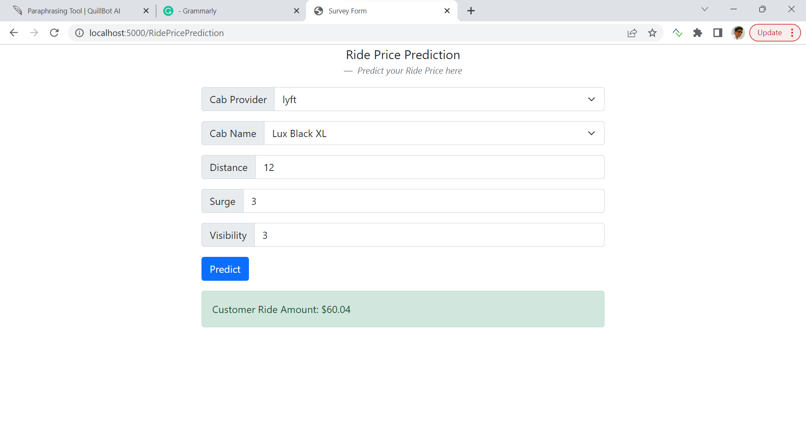
Results of the predictions

Slide 9

Thank You

